Slide 1










Alícia Oliveira
ML Engineer, DEUCALION & INESC TEC
alicia.oliveira@inesctec.pt

Slide 2
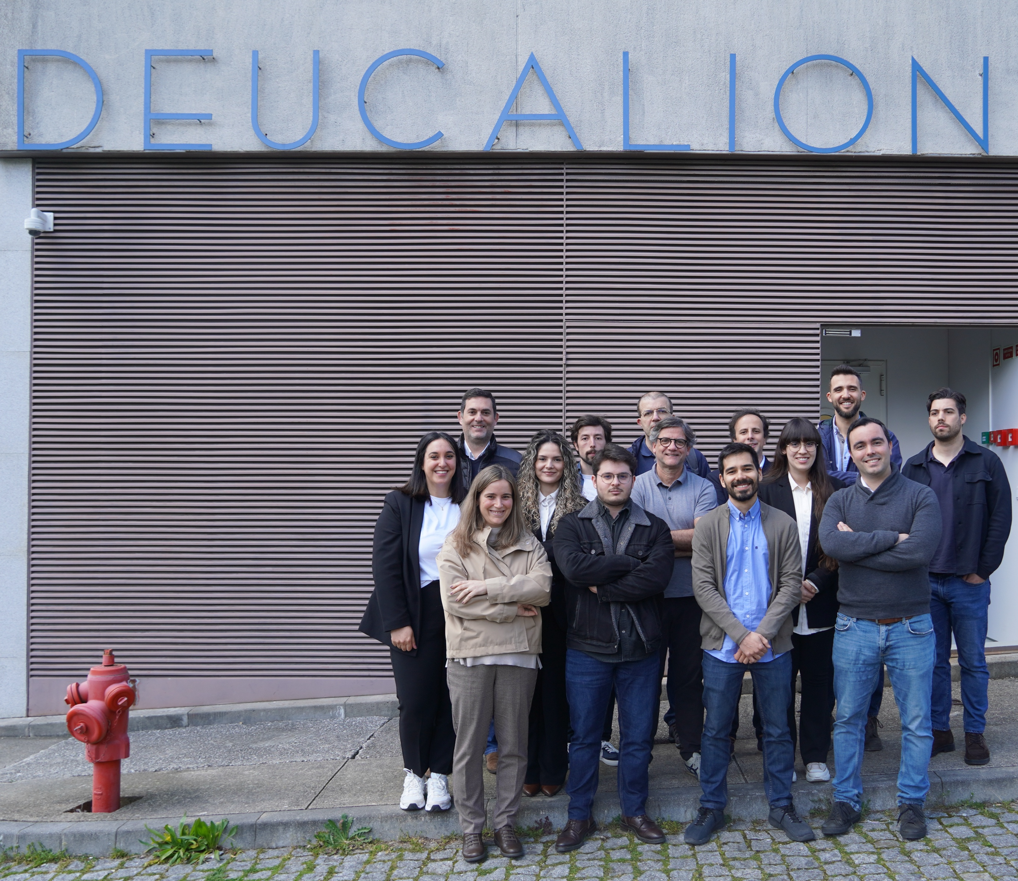
Alícia Oliveira
ML Engineer, DEUCALION & INESC TEC
alicia.oliveira@inesctec.pt

Slide 3



Deucalion enables efficient AI training
ARM Partitions
X86 Partitions
1632 nodes
500 nodes + 33 GPU nodes
A64FX chip (48 cores)
2 x AMD EPYC 7742 per node (128 cores)
32 GB HBM2 RAM (50% faster)
256 GB RAM
52 TB Total RAM
128 TB Total RAM
Both the ARM partition and the 132 Nvidia A100 GPUs enable the training and inference of medium-scale AI models.
03

Slide 4
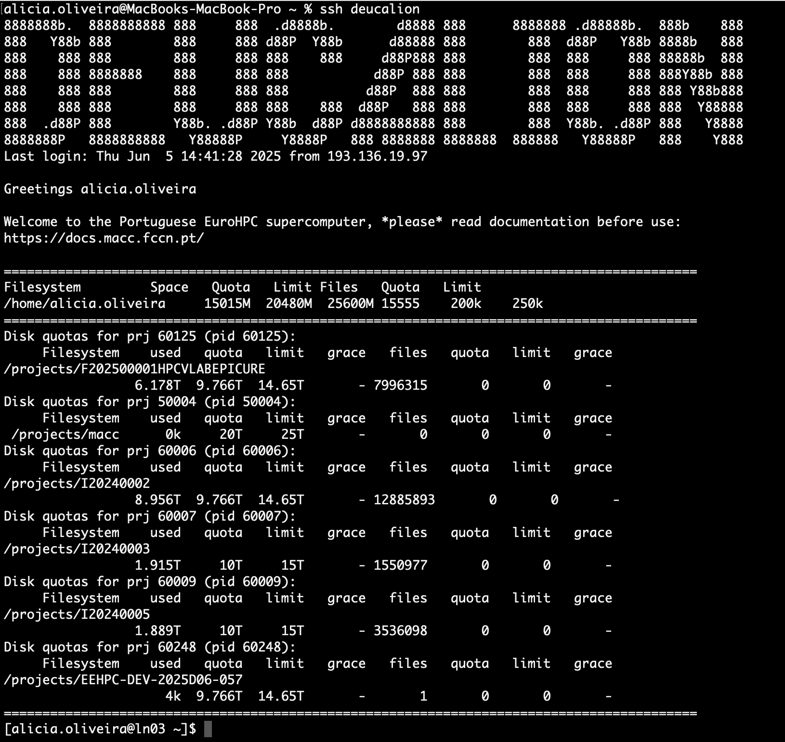

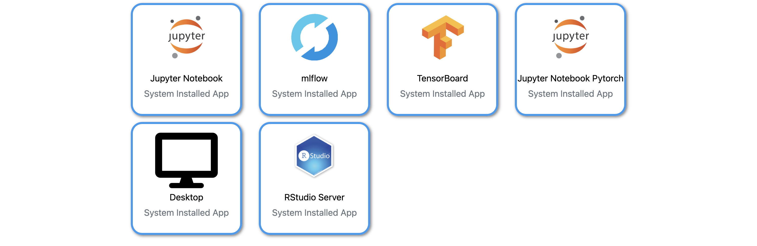
How can users access Deucalion?
Terminal
Open OnDemand
04

Slide 5

Open OnDemand Apps

Slide 6
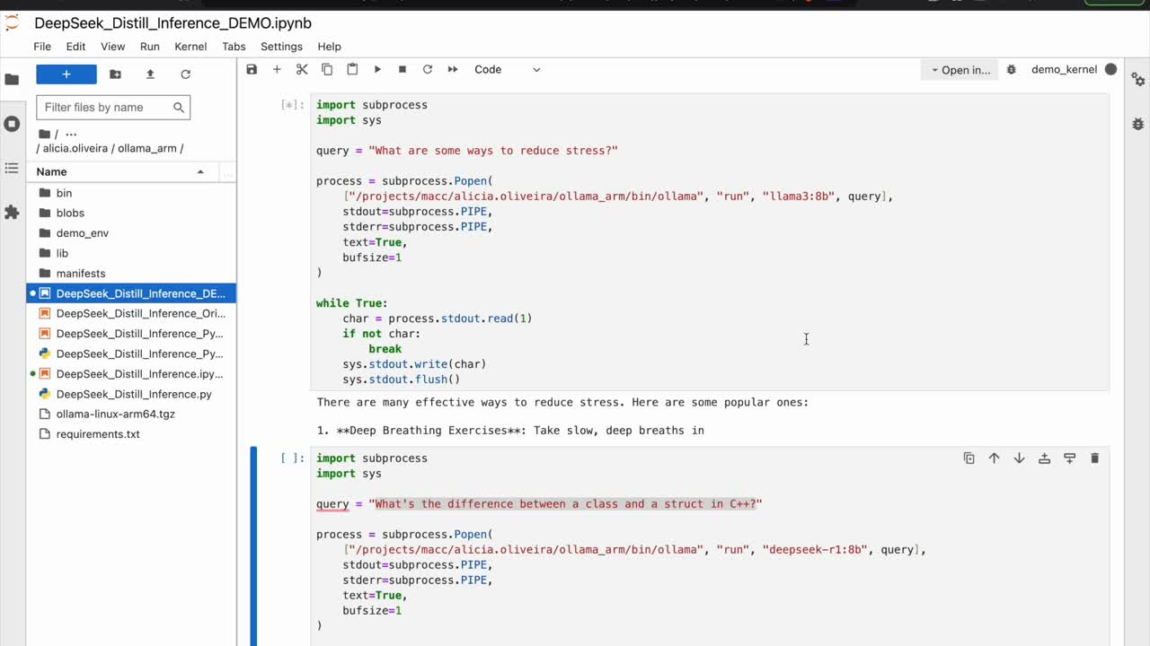

Slide 7

Open OnDemand Apps

Slide 8
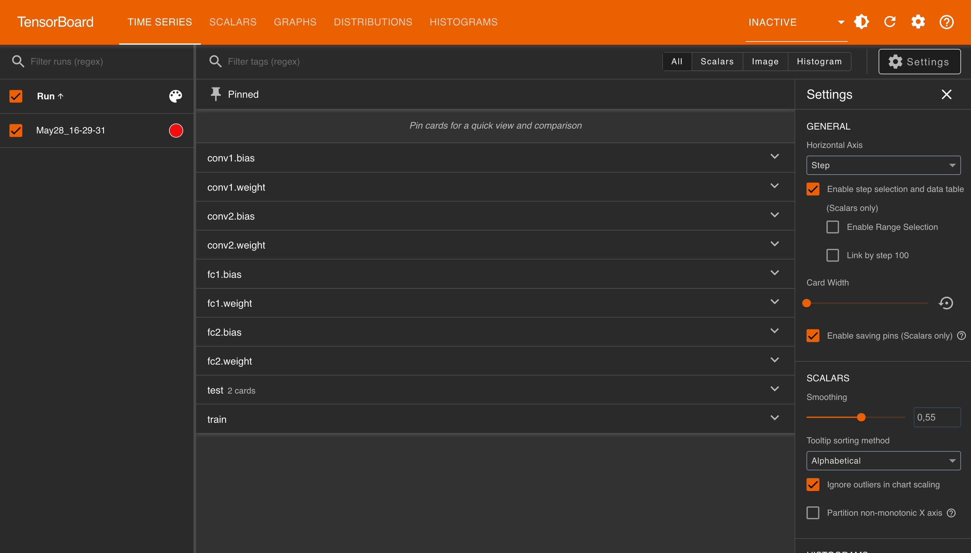

Slide 9

Open OnDemand Apps

Slide 10
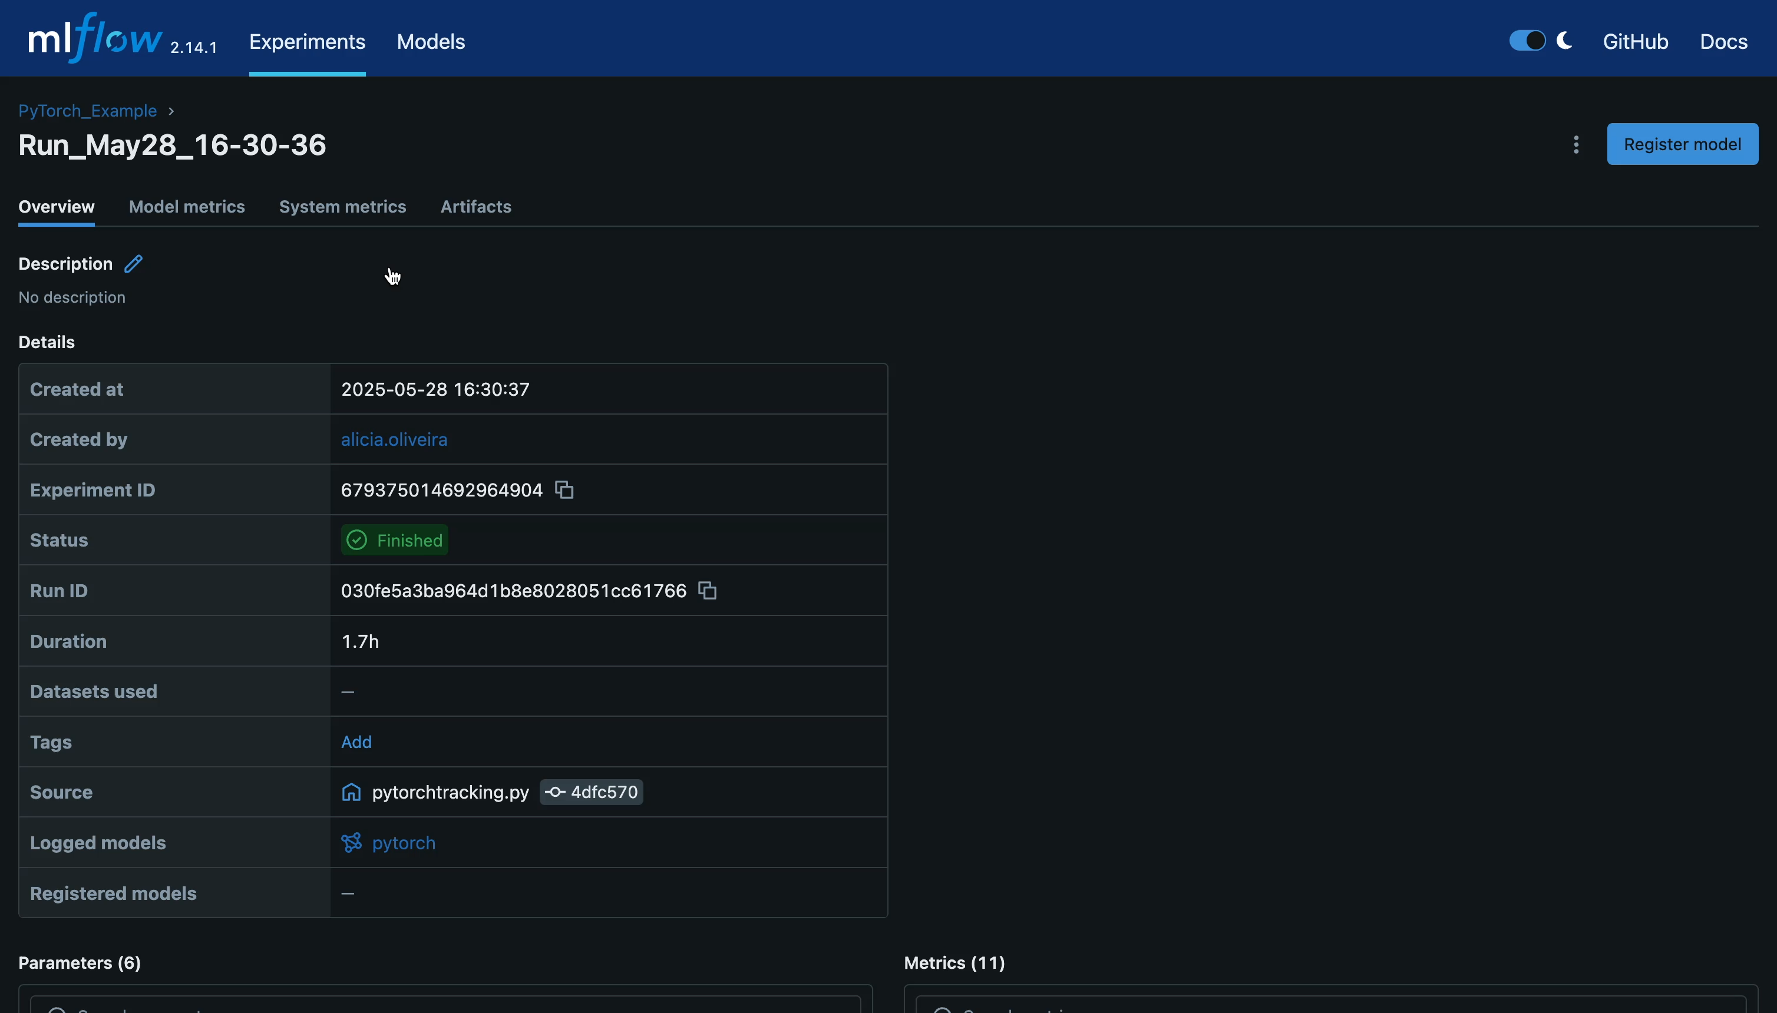

Slide 11
Distributed Inference of Large Language Models

Slide 12




What is a Large Language Model?
Can learn patterns in language and can perform tasks
Trained on massive amounts of data
Type of AI model
Can understand and generate human language
Can produce a natural language response
Uses probability to produce responses
12

Slide 13

Why Distribute LLMs?
Training
Fine Tuning
Inference
Training is the initial process of teaching a machine learning model by exposing it to a large dataset so it can learn patterns, features, and relationships in the data.
Fine-tuning is the process of taking a pretrained model and continuing training on a smaller, task-specific dataset to adapt it to a specialized use case.
Inference is the process of using a trained or fine-tuned model to make predictions or generate outputs based on new, unseen input data.
13

Slide 14

Distributed Llama
  1
  2
  3
Llama 3.1
405B
4 GPUs
per Node
128 Cores
per Node
> 2 TB
80 GB
per GPU
32 Cores
per GPU
8 GPU Nodes
32 GPUs
1024 Cores
14

Slide 15
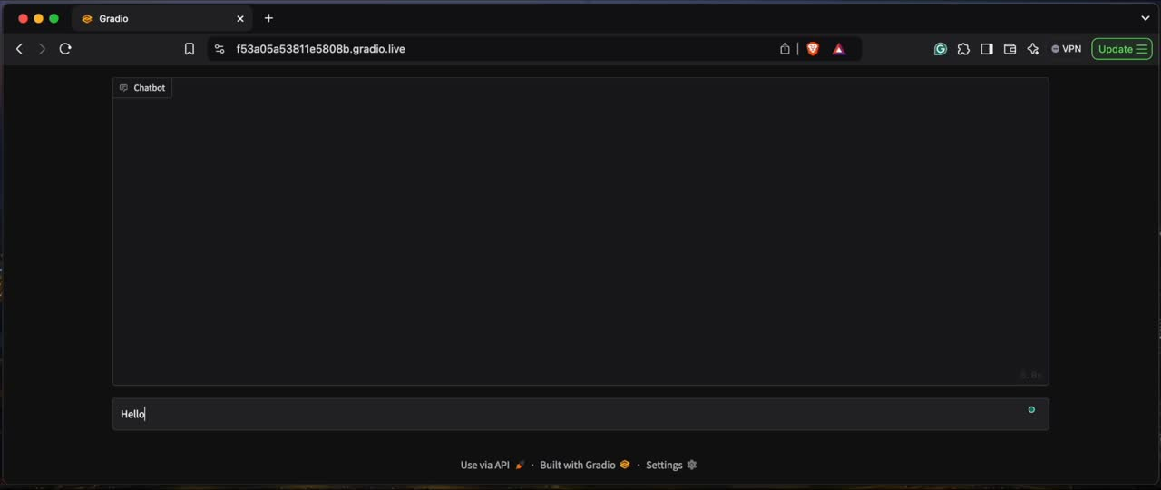
Distributed Llama on Multiple GPUs

Slide 16
Alícia Oliveira
ML Engineer, DEUCALION & INESC TEC
alicia.oliveira@inesctec.pt

